Slide 1
Timing and indication of surgery- Mitral valve
Dr. Kailash Kr Goyal

Slide 2
Indications for intervention
Presence or absence of symptoms.
Severity of valvular heart disease.
Response of the left or right ventricle to the volume or pressure overload caused by VHD.
The effect on the pulmonary or systemic circulation.
Change in heart rhythm.
Nishimura, RA et al. 2014 AHA/ACC VHD guidelines

Slide 3
Nishimura, RA et al. 2014 AHA/ACC VHD guidelines

Slide 4
Nishimura, RA et al. 2014 AHA/ACC VHD guidelines

Slide 5
Nishimura, RA et al. 2014 AHA/ACC VHD guidelines

Slide 6
Nishimura, RA et al. 2014 AHA/ACC VHD guidelines

Slide 7
Nishimura, RA et al. 2014 AHA/ACC VHD guidelines

Slide 8
How to Assess Mitral Stenosis
Level 1 Recommendations:
- Pressure gradient
- MVA Planimetry
- Pressure half-time
Level 2 Recommendations:
- Continuity equation
- Proximal isovelocity surface area method (PISA)
- Stress echocardiography
Echocardiographic assessment of valve stenosis:EAE/ASE recommendations for clinical practice

Slide 9
Pressure gradient
Estimation of diastolic pressure gradient is based on simplified Bernoulli equation ∆P = 4V²
Estimation has good correlation with invasive measurement using transseptal catheterization
Gradient is measured in the apical window.
Continuous wave doppler is preferred.
Color doppler is used to identify eccentric mitral jets.

Slide 10
Pressure gradient
Maximal & mean gradient are calculated.
Mean gradient is relevant hemodynamic finding.
Maximal gradient is derived from peak mitral velocity, which is influenced by left atrial compliance & LV diastolic function.
In AF : Avg of 5 cycles with least variation
of R-R interval .
HR at which gradients are obtained to be noted.

Slide 11
Pressure gradient
Not the best marker of severity of MS.
Depend on heart rate, cardiac output(CO) & associated MR.
Tachycardia, increased CO & associated MR overestimates gradient.

Slide 13
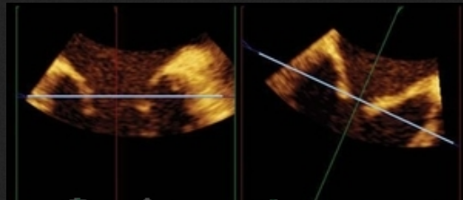
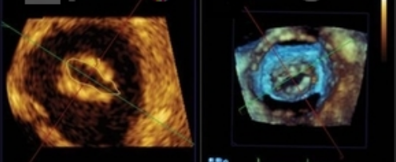
MVA by Planimetry
Planimetry is considered as reference measurement of MVA.
Direct tracing of mitral orifice including opened commissures in PSAX view at mid-diastole.
CSA is measured at the leaflet tips.

Slide 14
MVA by Planimetry
Gain setting should be just sufficient to visualize the contour of the mitral orifice.
Excessive gain setting may cause underestimation of valve area.
3D echo imaging improves reproducibility and accuracy of planimetry measurement.

Slide 15
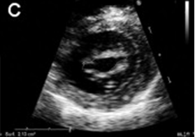
Both commissures are fused
Unicommissural opening
Bicommissural opening

Slide 16
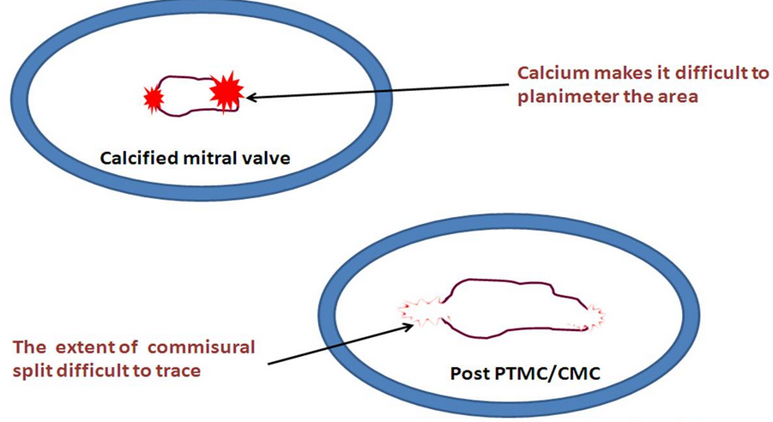
Advantages of planimetry
Direct measurement of MVA.
Does not depend on flow conditions, cardiac chamber compliance or associated valvular lesions.
Best correlation with anatomic valve area of explanted valves.
Disadvantage
Not feasible in poor
acoustic window and
severe valve calcification.

Slide 17
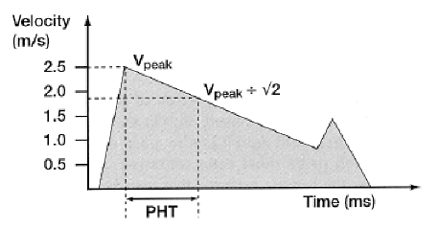
Pressure half-time (PHT)
PHT is defined as time interval in msec
between maximum mitral gradient in early
diastole & time point where the gradient
is half the maximum initial value.
Decline of the velocity of diastolic transmitral
blood flow is inversely proportional to valve area.
MVA is derived using the empirical formula
MVA = 220/PHT

Slide 18
Pressure half-time
In addition to MVA , PHT depends on net compliance of LA & LV and maximum transmitral gradient .
PHT obtained by tracing the deceleration slope of E-wave on Doppler spectral display of transmitral flow.

Slide 20
Measuring T_{1/2} with a bimodal slope of E-wave
Deceleration slope in mid-diastole rather than early to be traced

Slide 21
Factors affecting PHT
LA pressure decline
ASD : LA draining to second chamber.
Stiff LA – low LA compliance
LA pressure drop rapidly and PHT is shortened.
LV pressure rise
AR : LV fills from a second source .
Stiff LV (stiff-low ventricular compliance)
LV pressure may rise more rapidly and PHT will be shortened.
All these results in overestimation of MVA

Slide 22
PHT after BMV
PHT is inaccurate soon after acute valvotomy.
Usually increase in mean gradient is compensated by decrease in compliance.
Immediately after BMV there is discrepancy between decrease in mitral gradient and increase in net compliance.

Slide 23
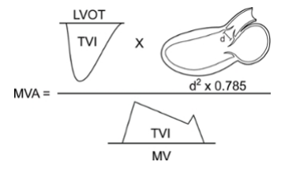
Continuity equation
Continuity equation is based on the conservation of mass.
Filling volume of diastolic mitral flow is equal to aortic SV.
MVA = π D² X VTI aortic
4 VTI mitral
D - diameter of the LVOT (cm)
VTI – Velocity Time Integral (cm)
SV can also be estimated from
the pulmonary artery.

Slide 24
Disadvantages
Needs multiple measurements and increased chance for errors.
Cannot be used in AF or associated significant MR or AR.

Slide 25
Proximal Isovelocity Surface Area (PISA)
Diastolic mitral flow converges on atrial side of stenotic mitral valve producing multiple shells of isovelocity hemispheres.
MVA = 2πr² x AV x α
MV 180
r : radius of convergence hemisphere (cm)
AV : aliasing velocity (in cm/s)
MV : peak Mitral velocity (cm/s)
α : opening angle of mitral leaflets relative to flow direction.

Slide 26
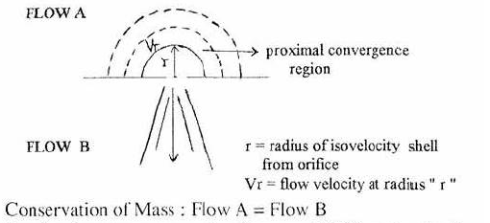
PISA

Slide 27
PISA
Advantages.
Can be used in presence of significant MR , AR & differing heart rhythms
Not affected by LA or LV compliance.
Disadvantage.
Technical difficulty.

Slide 28
MITRAL VALVE RESISTANCE
Level 3 reccomendation
MVR=Mean mitral gradient/ transmitral diastolic flow rate
Transmitral diastolic flow rate= SV/DFP
It correlate well with pulmonary artery pressure

Slide 29
WILKINS SCORE

Slide 30
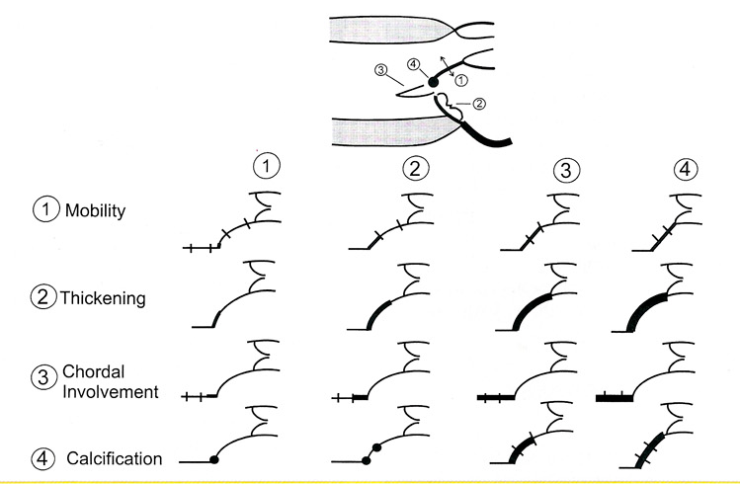

Slide 39
Pregnancy

Slide 41
Mitral regurgitation

Slide 42
Organic- Primary Pathology of the Leaflets:
1.Rheumatic 2.Infective Endocardtis 3.Ischemic-Papillary Muscle Rupture 4.Degenerative Barlow, Fibroelastic degeneration Marfan,Ehler’s-Danlos Mitral Annular Calcification 5.Amyloid,Hyperesinophilic Syndrome 6.Congenital-Cleft AML
Functional- Mal-Coaptation secondary to Myocardial Disease:
1.Ischemic-AWMI,IWMI 2.DCM,HOCM

Slide 50
MR severity assessment
Doppler parameters
# Color flow jet area
# jet density
# jet contour
# pulmonary vein flow Quantitative Methods # Vena contracta # PISA Method

Slide 51
Colour flow Doppler
Most common way to assess MR severity
Assumption:
as the severity of the MR increases, the size and
the extent of the jet into the LA also increases.
Relation between jet size and MR severity presents a large range of variability.
Patients with increased LA pressure or with eccentric jets that hug the LA wall or in whom the LA is enlarged may exhibit smaller jets area than those with normal LA pressure and size or with central jets

Slide 52
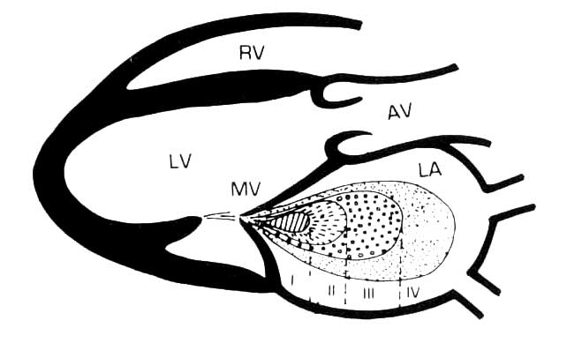
Colour flow Doppler –jet area
Mild = Less than 20% of LA area (<4cm²) moderate = 20 to 40% severe = More than 40% (>10 cm² )
Zoghbi et al. ASE valve regurg document (JASE 03)

Slide 53
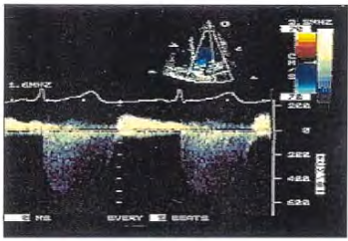
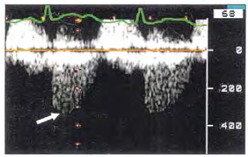
Continuous Wave Doppler
MILD SEVERE
Density Faint Dense
Shape Symmetrical Asymmetrical

Slide 54
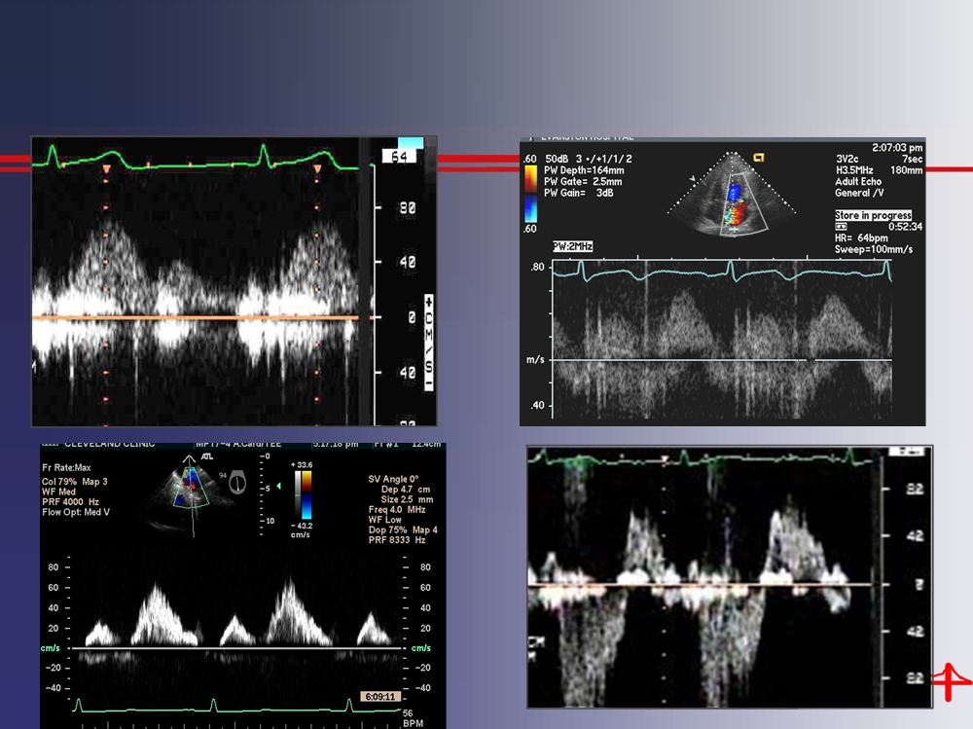
Pulmonary vein flow
S
D
D
S
1-Normal
2-Systolic blunting
D
S
D
S
3-Diastolic dominant
4-Systolic Flow Reversal

Slide 55
Vena contracta width
Narrowest portion of a jet that occurs at or just downstream from the orifice.
Must be taken in plane perpendicular to the commissural line that is the parasternal long axis view.
Size of the VC independent of flow rate and driving pressure for a fixed orifice.
May change with hemodynamic or during the cardiac cycle
Works equally well for central and eccentric jets.

Slide 56
PISA Method

Slide 58
 | Mild Grade I | Moderate Grade 2 Grade3 | Severe Grade 4
Regurgitation volume ml / beat | <30 | 30-44 45-59 | >60
Regurgitation Fraction % | <30 | 30-39 40-49 | >50
Regurgitation Orifice area cm² | <0.20 | 0.20-0.29 0.30-0.39 | >0.40
In functional ischemic MR: EROA ≥ 20 mm² or a R Vol ≥ 30 mL identifies a subset of patients at increased risk of cardiovascular events.

Slide 59
Specific signs of severity :
Large central MR jet > 8cm²
MR area / LA area > 40%
Eccentric wall- impinging jet of any size, swirling in LA
Vena contracta width > 7mm
Large flow convergence
Systolic reversal in pulmonary veins
Severe MR
Supportive signs :
Dense, triangular CW Doppler MR jet
E-wave dominant mitral inflow ( > 1.2 m/sec)
Enlarged LV and LA
( particularly with normal LV function )
Quantitative Parameters:
R Vol (ml / beat) > 60 , RF (%) > 50 , EROA (cm²) > 0.40

Slide 60
Specific signs of severity :
Small central jet < 4cm²
MR area / LA area < 20%
Vena contracta width < 3mm
No or minimal flow convergence
MILD MR
Supportive signs :
Systolic dominant flow in pulmonary veins
A – wave dominant mitral Inflow
Soft density, parabolic CW Doppler MR signal
Normal LV,LA size
Quantitative Parameters:
R Vol (ml / beat) < 30 / RF (%) < 30 / EROA (cm²) < 0.20

Slide 61
Specific signs of severity :
MR jet size 4 to 8 cm
MR jet area / LA area 20 – 40 %
Vena contracta width 3.0 – 6.9 mm
Supportive signs :
Pulmonary vein - decreased systolic velocity but no
reversal
MODERATE MR
Quantitative Parameters:
R Vol (ml / beat) 30 – 44 45 - 59
RF (%) 30 – 39 40 – 49
EROA (cm²) 0.20 – 0.29 0.30 - 0.39

Slide 79
Thank you

